Slide 1

NHS
DATA
Utilizing SQL for Clinical Data Analysis
By Lateefat Tobun & Ibrahim Oshinubi

Slide 2


Overview
01
Introduction
04
Multiple Myeloma
02
Dataset
05
Crohn’s Disease
03
Haemoglobin Level
06
Contact

Slide 3

Introduction
Utilizing SQL for querying clinical data in a research and development environment. Three distinct scenarios are presented, each requiring the extraction of specific data from the provided database schema:
Analysing anaemia prevalence and trends.
Analysing impact of Multiple Myeloma incidences
Identifying at-risk patients for urgent medical advice.

Slide 4


Dataset
PATIENTS
Table
BLOOD_TESTTable
INPATIENT_SPELLS
Table
DIAGNOSIS
Table
containing IDs and demographic data for each unique patient
containing the results of all pathology blood tests undertaken for patients.
containing IDs and demographic data for each unique patient
containing ICD-10 coded diagnoses made by clinicians, recorded during inpatient spells. Due to comorbidity recording, multiple diagnoses may be made for each spell.
PATIENT_ID: [int]
GENDER: [varchar]
POSTCODE: [varchar]
CURRENT_AGE: [int]
DATE_OF_DEATH: [date]
RESULT_ID: [int]
PATIENT_ID: [int]
SAMPLE_DATE: [date]
RESULT_DATE: [date]
TEST: [varchar]
RESULT: [int]
UNIT: [varchar]
RANGE_FLAG: [varchar]
SPELLS_ID: [int]
PATIENT_ID: [int]
ADMISSION_DATE: [date]
DISCHARGE_DATE: [date]
SPELLS_ID: [int]
DIAGNOSIS_CODE: [int]
DIAGNOSES: [date]

Slide 5



Anaemia & Haemoglobin Levels
Testing
A blood sample is collected from the patient.
Target
This analysis is relevant for assessing anaemia prevalence and trends.
Haemoglobin is a protein found in red blood cells that carries oxygen throughout the body. Abnormal levels of haemoglobin can indicate various conditions, including anaemia.

Slide 6



SQL Query
Objective:
Investigate fluctuating levels of anaemia over time by examining haemoglobin levels in blood test data for female patients aged 18 and over in the ‘SO’ area.
CODE:
SELECT * from PATIENTS
JOIN BLOOD_TESTS
ON PATIENTS.PATIENT_ID = BLOOD_TESTS.PATIENT_ID
WHERE PATIENTS.CURRENT_AGE >=18
AND PATIENTS.GENDER = 'Female'
AND BLOOD_TESTS.TEST LIKE'Haemoglobin'
AND PATIENTS.POSTCODE LIKE 'SO%'
AND BLOOD_TESTS.SAMPLE_DATE BETWEEN '2015-01-01' AND '2022-12-31'
Result: This query retrieves all relevant blood test data for female patients aged 18 and over in the ‘SO’ area, specifically focusing on haemoglobin levels between January 1, 2015, and December 31, 2022

Slide 7

Multiple Myeloma
Multiple Myeloma is a cancer of plasma cells, a type of white blood cell present in the bone marrow. It leads to the overproduction of abnormal plasma cells, which can cause bone pain, anaemia, kidney damage, and other complications.
Testing
Diagnosis typically involves a combination of blood tests, urine tests, imaging studies, and bone marrow biopsy.
Target
Analysing the incidence of Multiple Myeloma and its impact on hospital admissions over time.

Slide 8

SQL Query
Objective:
Extract inpatient spells for patients diagnosed with Multiple Myeloma and provide a total count of distinct spells per year.
CODE:
--Total Multiple Myeloma diagnosis
SELECT * FROM DIAGNOSES
JOIN INPATIENT_SPELLS
ON DIAGNOSES.SPELL_ID = INPATIENT_SPELLS.SPELL_ID
WHERE DIAGNOSIS LIKE 'Multiple Myeloma';
--Yearly multiple Myeloma diagnosis
SELECT YEAR(INPATIENT_SPELLS.ADMISSION_DATE) AS YEAR, COUNT(INPATIENT_SPELLS.PATIENT_ID) AS Cases FROM DIAGNOSES
JOIN INPATIENT_SPELLS
ON DIAGNOSES.SPELL_ID = INPATIENT_SPELLS.SPELL_ID
WHERE DIAGNOSIS LIKE 'Multiple Myeloma'
GROUP BY YEAR(INPATIENT_SPELLS.ADMISSION_DATE);
Result:
The first query retrieves all inpatient spells with a diagnosis of Multiple Myeloma.
The second query provides a yearly count of distinct spells including this diagnosis, offering insights into the incidence of the disease over time.

Slide 9


Crohn’s Disease
Crohn’s Disease is a chronic inflammatory bowel disease that affects any part of the gastrointestinal tract. It leads to inflammation, ulcers, and other complications, causing symptoms such as abdominal pain, diarrhoea, weight loss, and fatigue.
Testing
Diagnosis involves a combination of medical history, physical examination, laboratory tests, imaging studies, and sometimes biopsy of affected tissues.
Target
Analysis to identify immunocompromised Crohn’s Disease patients to provide them with urgent medical advice regarding COVID-19 precautions.

Slide 10

SQL Query
Objective:
Generate a list of immunocompromised Crohn’s Disease patients for urgent medical advice, based on specific ICD-10 codes (K500, K501, K508, K509)
CODE:
SELECT * FROM(
(INPATIENT_SPELLS JOIN DIAGNOSES ON DIAGNOSES.SPELL_ID = INPATIENT_SPELLS.SPELL_ID)
LEFT JOIN PATIENTS ON PATIENTS.PATIENT_ID = INPATIENT_SPELLS.PATIENT_ID)
WHERE DIAGNOSES.DIAGNOSIS_CODE IN ('K500', 'K501', 'K508', 'K509');
Result: This query retrieves data of patients diagnosed with Crohn’s Disease, allowing the medical team to identify and advise immunocompromised patients regarding COVID-19 precautions.

Slide 11



Further Analysis
Excel
Power BI
Utilise Excel to import and organize clinical data, conduct exploratory analysis, and create visualizations for initial insights.
Leverage Power BI for advanced analytics and interactive dashboards, enabling dynamic exploration and presentation of key findings.

Slide 12
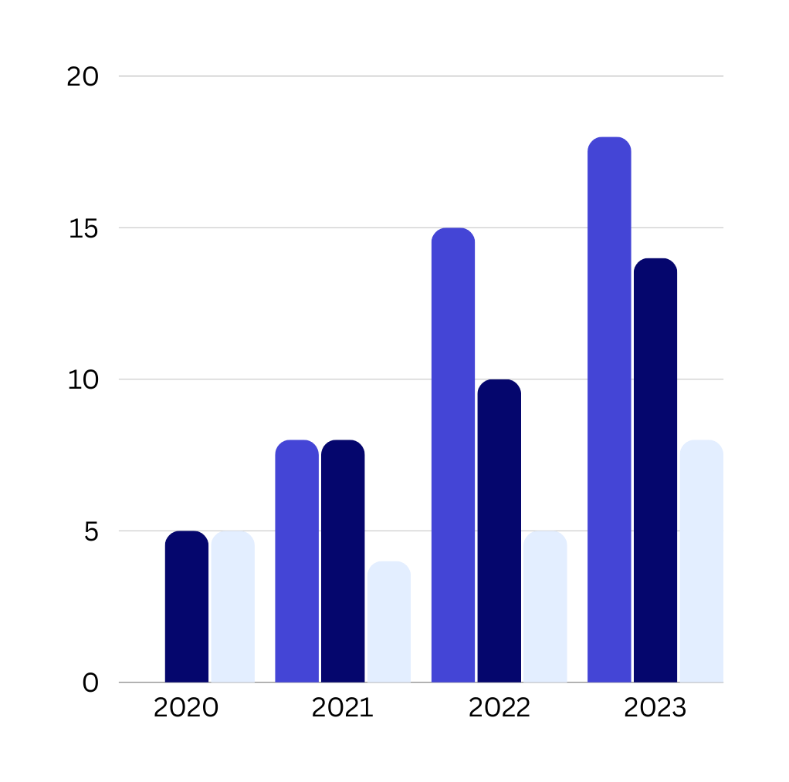

For Health Data Analysis
Connect with us.
ibrahim.oshinubi@gmail.com
tobunlateefat@gmail.com

